Slide 1


Slide 2


Slide 3
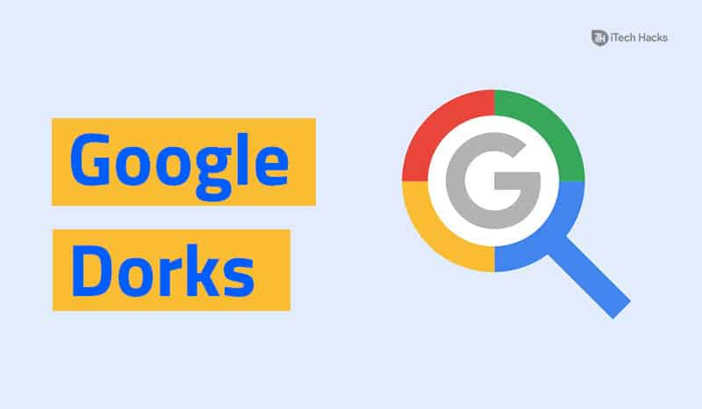
What is a Google Dork?
A Google Dork, also known as Google Dorking or Google hacking, is a valuable resource for security researchers.
A Google dork is an employee who unknowingly exposes sensitive corporate information on the Internet
Google Hacking is a hacker technique that uses Google Search and other Google applications to find security holes in the configuration and computer code that websites use.
Google dorking can return usernames and passwords, email lists, sensitive documents, personally identifiable financial information (PIFI) and website vulnerabilities

Slide 4
Important Things To Know
Before starting with Google Dork, one needs to be aware that Google knows who you are and when you perform these kinds of activities.
Only use these information for legal purposes.
Just because the information are open on the internet, do not use it to harm others.
Any illegal activity caught on the internet, you will be charged as a cyber criminal.

Slide 5


Slide 6
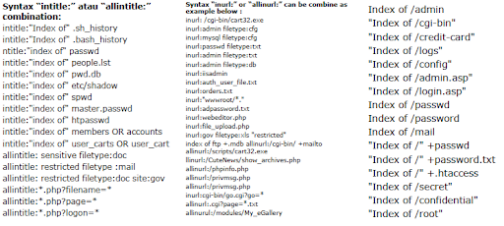

Slide 7
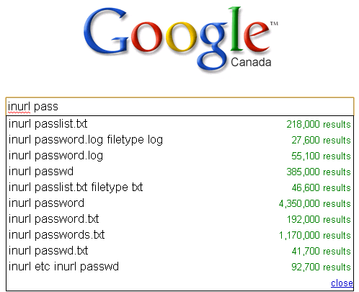
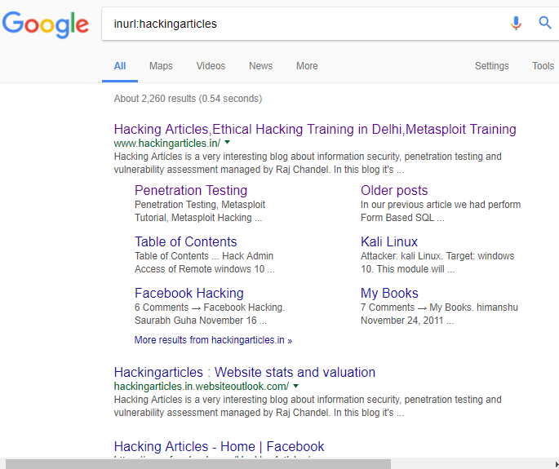
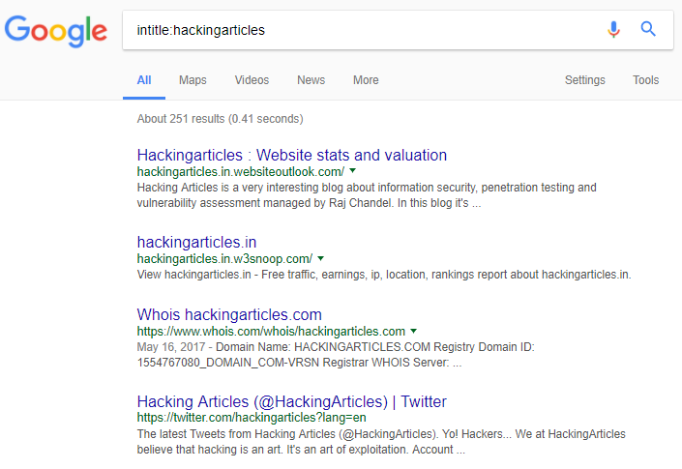

Slide 8
allintext: searches for specific text contained on any web page,
e.g. allintext: hacking tools
filetype :- used to search for any kind of file extensions, for example, if you want to search for pdf files you can use: email security filetype: pdf
intitle: Specifying intitle, will tell google to show only those pages that have the term in their html title.
For example intitle:"login page"
allinurl: it can be used to fetch results whose URL contains all the specified characters,
e.g: allinurl: client area
link: will show the list of web pages that have links to the specified URL,
e.g. link: microsoft.com

Slide 9
site: will show you the full list of all indexed URLs for the specified domain and subdomain,
e.g. site:securitytrails.co
Email Lists: will show the list of email IDs,
e.g. filetype:xls inurl:"email.xls“
Log files:Log files are the perfect example of how sensitive information can be found within any website
e.g. allintext:username filetype:log
the dork to fetch various IP based cameras:
inurl:top.htm inurl:currenttime
To find WebcamXP-based transmissions:
intitle:"webcamXP 5"

Slide 10

Google Hacking Database (GHDB)
https://www.exploit-db.com/
This is an index of search queries used to find publicly available info, intended for pentesters and security researchers.

Slide 11
Measures
Protect private areas with a user and password authentication and also by using IP-based restrictions.
Encrypt your sensitive information (user, passwords, credit cards, emails, addresses, IP addresses, phone numbers, etc).
Run regular vulnerability scans against your site, these usually already use popular Google Dorks queries and can be pretty effective in detecting the most common ones.
Run regular dork queries against your own website to see if you can find any important information before the bad guys do. You can find a great list of popular dorks at the Exploit DB Dorks database.
If you find sensitive content exposed, request its removal by using Google Search Console.

Slide 12
Practice Tutorial for Google Dorks
https://www.tutorialspoint.com/google_hacking_tests.htm

Slide 13
THANK YOU

